Slide 1

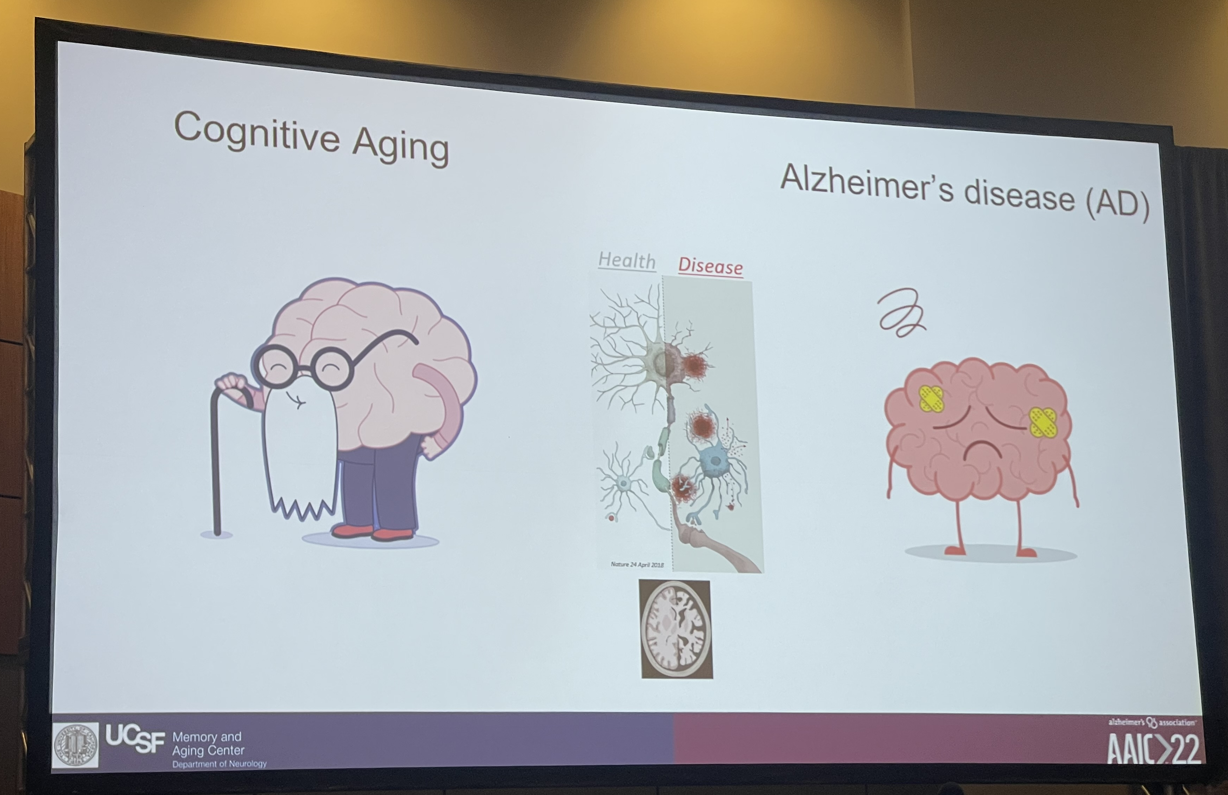
AAIC Recap
08-12-2022
Linh Le

Slide 2
Highlight session
Biomarkers (non-imaging)
Best combination of CSF biomarkers for predicting cognitive decline and clinical progression: A multi-cohort study (Gemma Salvado, Clinical Memory Research Unit, Lund University)
Biomarkers (genetics and neuroimaging)
APOE2 is associated with amyloid independent effects on tau PET signal in preclinical AD (Elizabeth C. Mormino, Stanford University School of Medicine)
Biomarkers of early pre-cortical changes in AD
Plasma ptau231 predicts locus coeruleus integrity earlier in life than other Alzheimer’s disease plasma markers: a 7T MRI study across the adult lifespan (Heidi I.L. Jacobs Massachusetts General Hospital, Harvard Medical School)
Lightning Presentation Round
Associations of Amyloid, White Matter Hyperintensities, and Hippocampal Volume with Cognitive Trajectories in the Oldest-Old: The 90+ Study (Jingxuan Wang, University of California, San Francisco)
Association between plasma Alzheimer’s disease markers and MRI markers of cerebral small vessel disease and neurodegeneration: the SMART-MR Study (Emma L. Twait Julius Center for Health Sciences and Primary Care, University Medical Center Utrecht and Utrecht University)
Poster
Synthesizing Images of Tau pathology from cross-modal neuroimaging using deep learning (Jeyeon Lee, Mayo Clinic)
Pathological tau in cognitively normal older adults predict prospective neurodegeneration and cognitive decline (Xi Chen, University of California, Berkeley)
Prevention (non-pharmacological): Exercise and Cognition: More evidence from across the lifespan

Slide 3
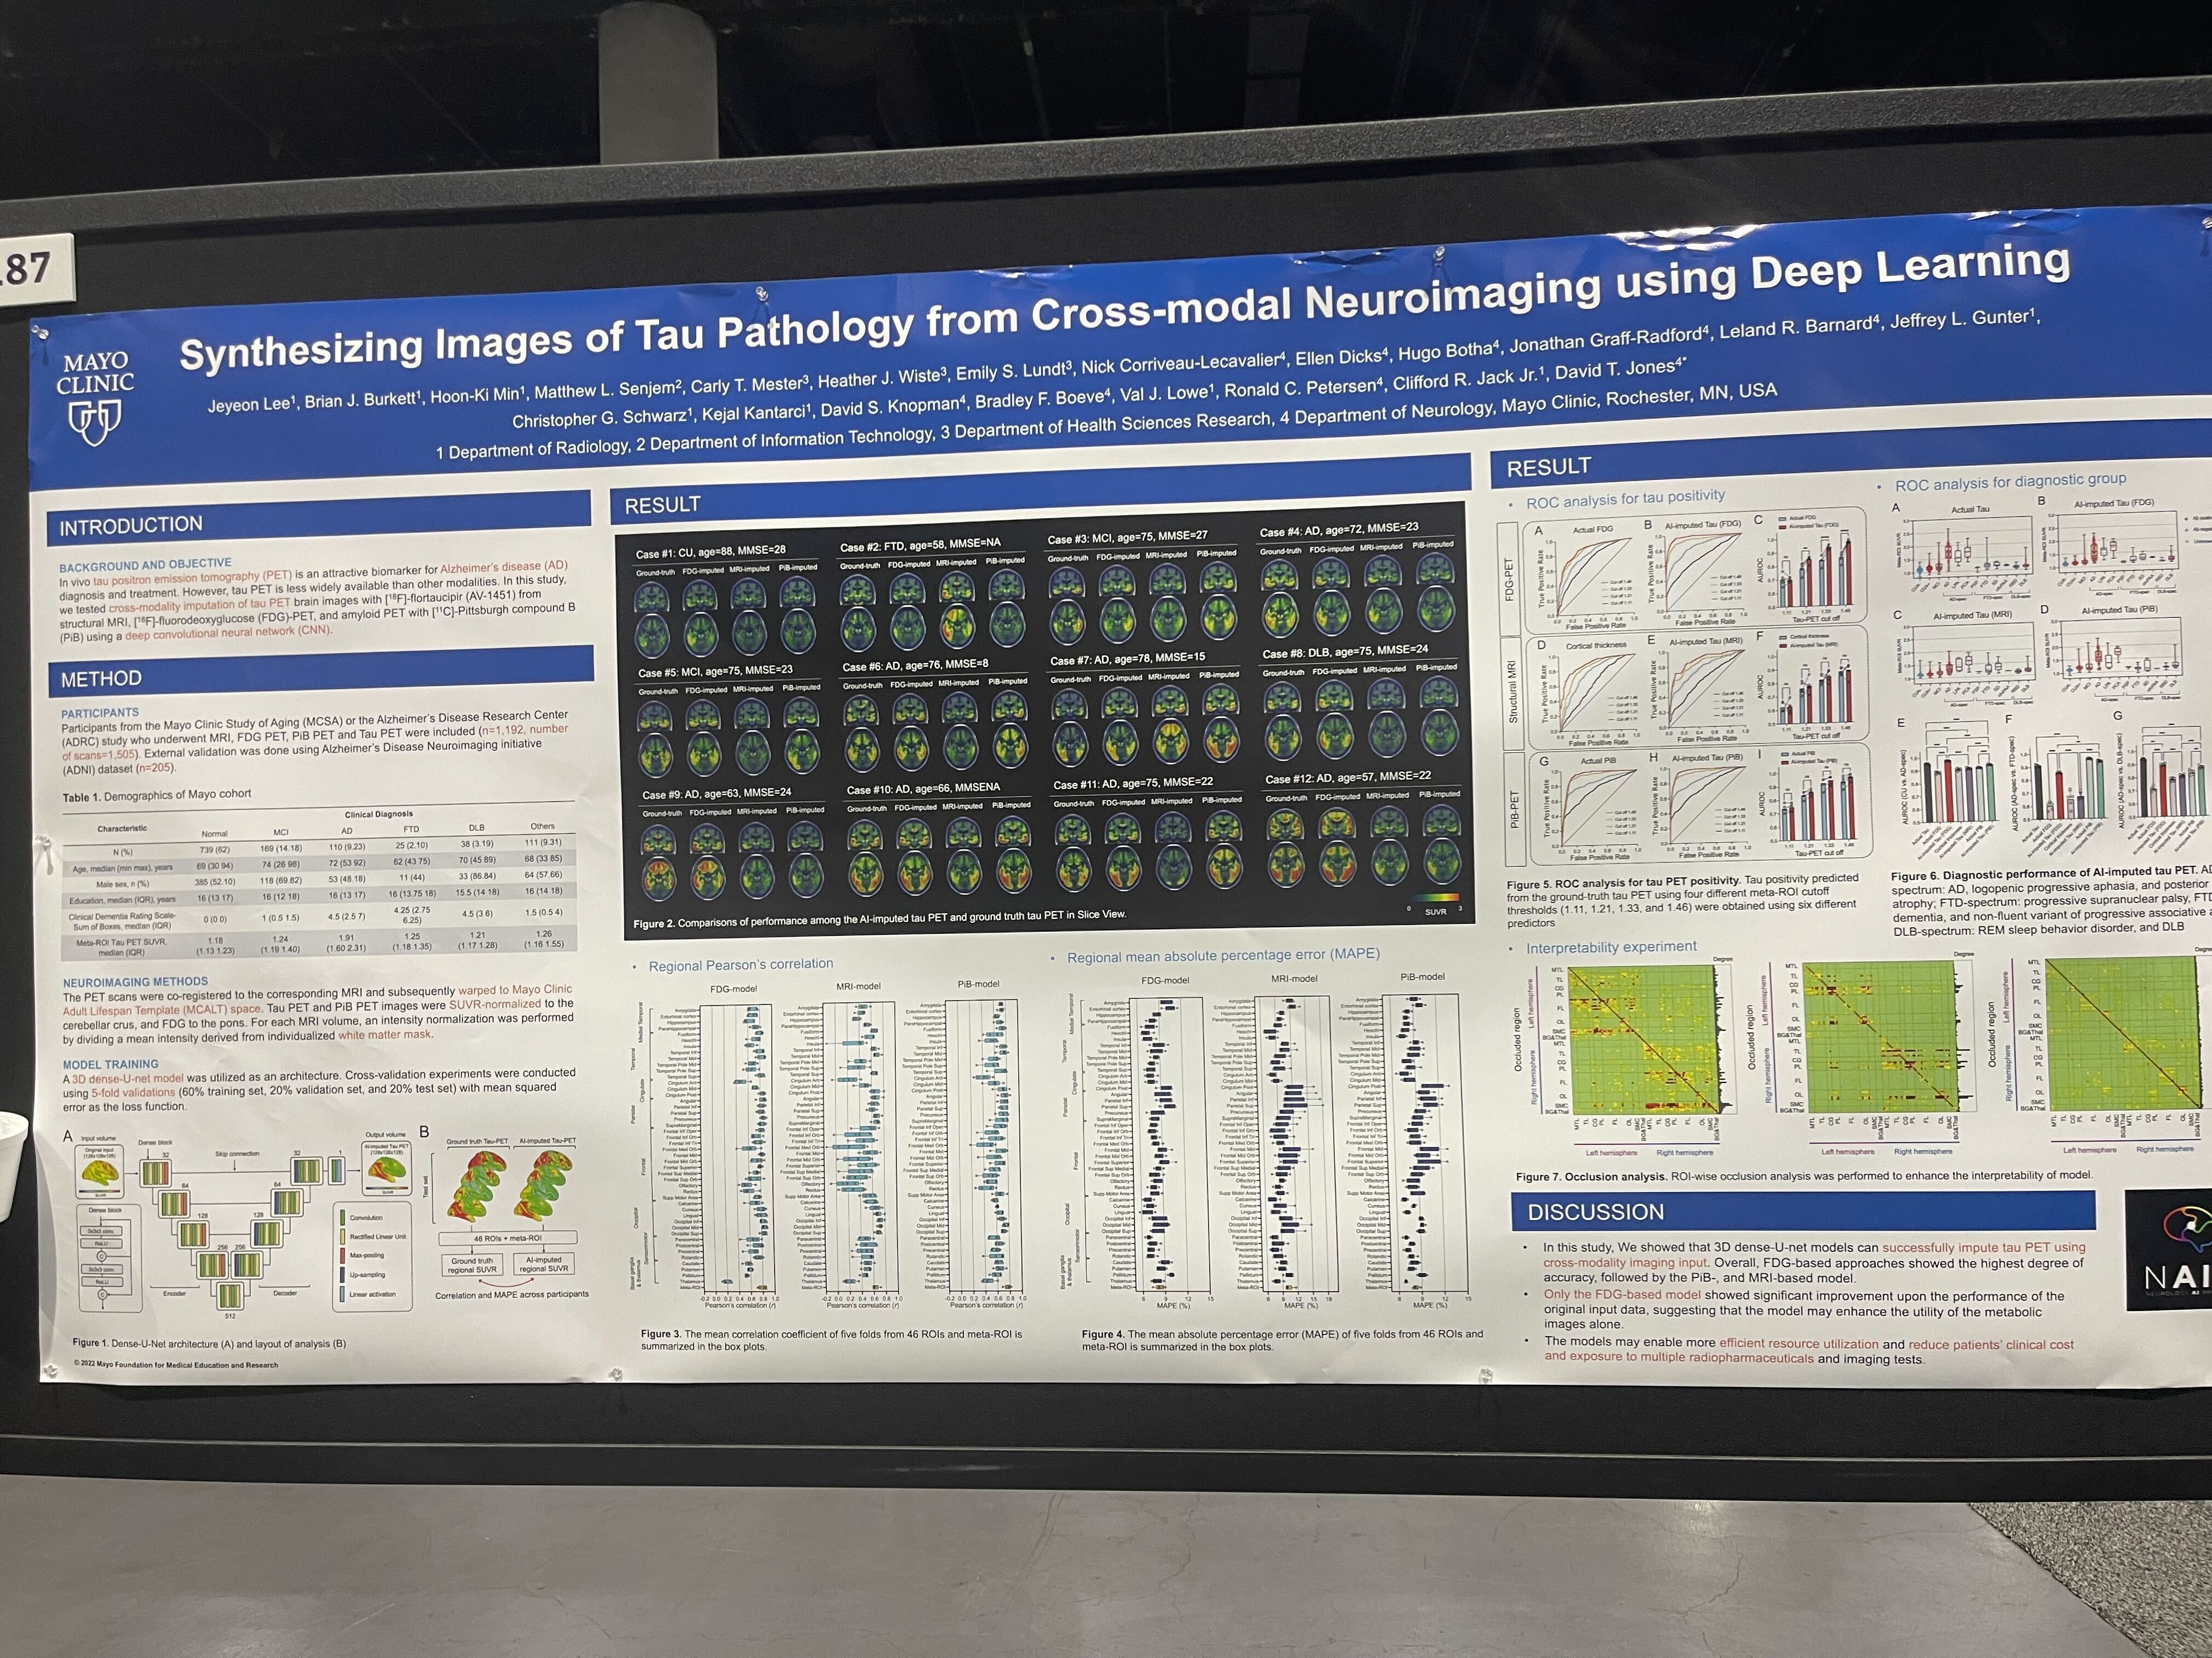

Slide 4
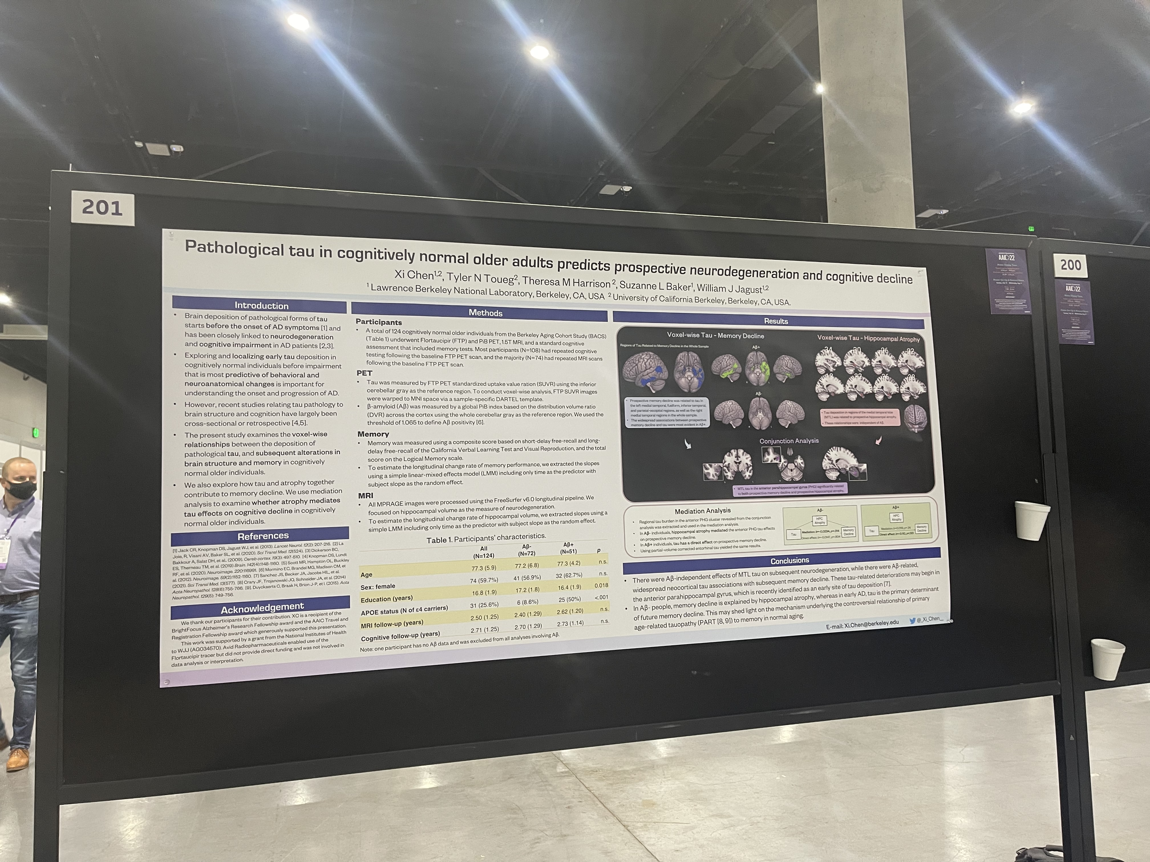

Slide 5
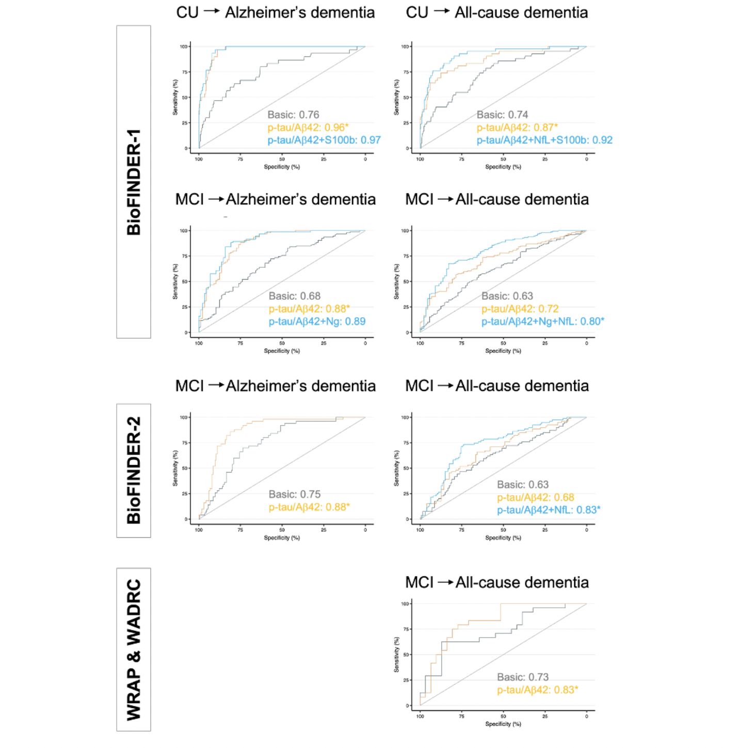
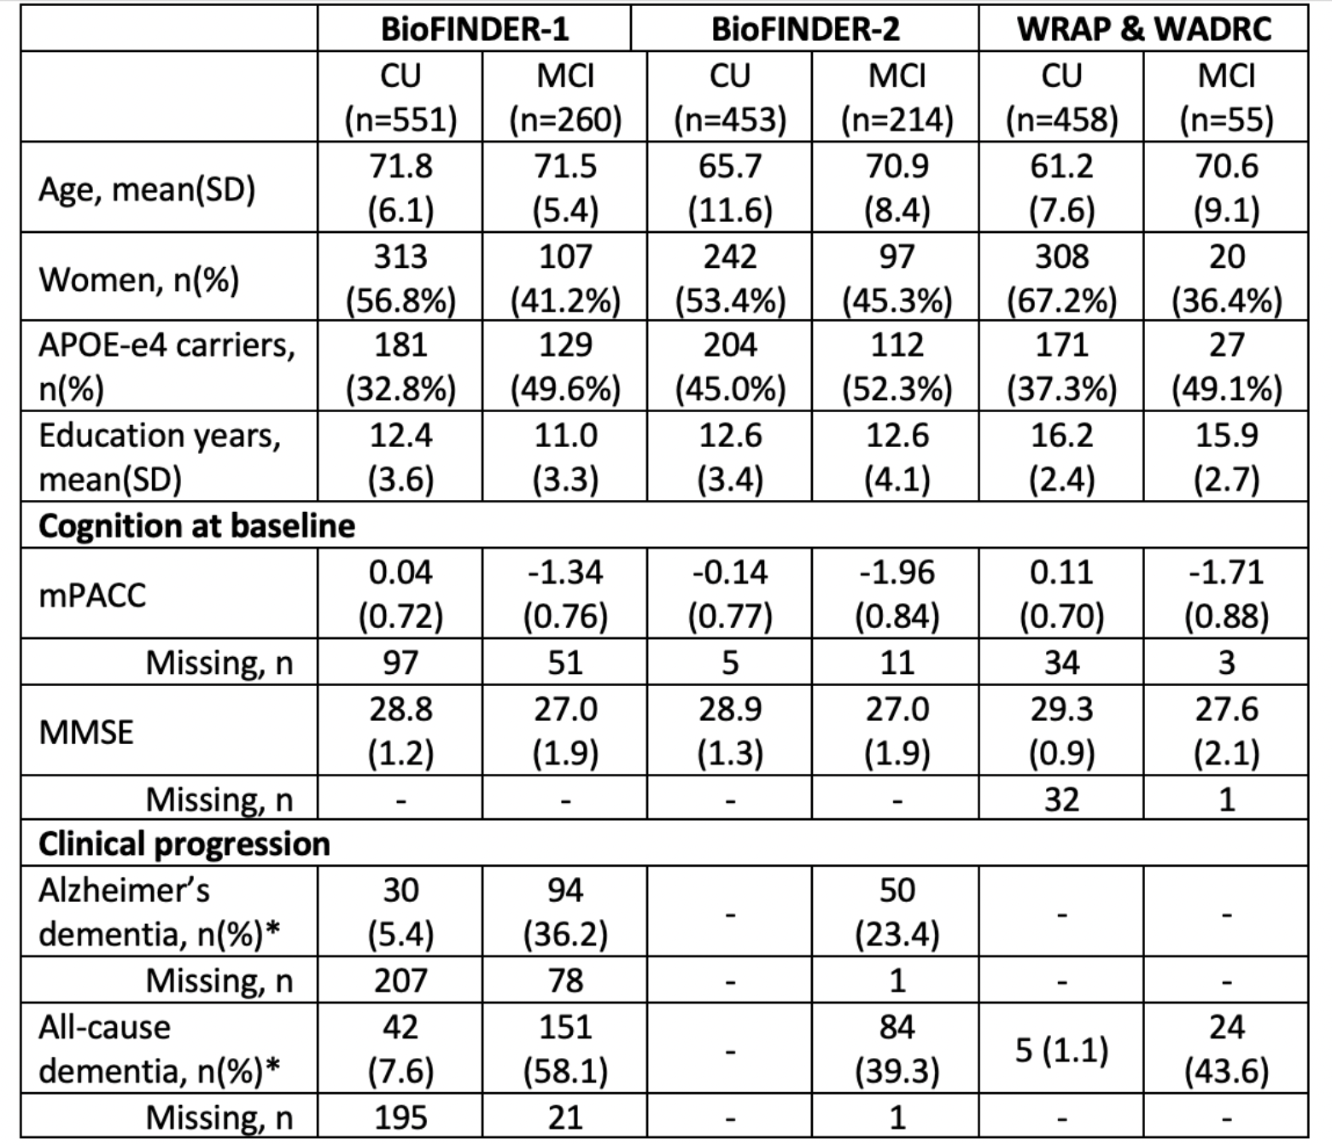
Best combination of CSF biomarkers for predicting cognitive decline and clinical progression: A multi-cohort study
Notes:
In this study, we included 1,991 participants (cognitively unimpaired [CU], n=1,462; mild cognitive impairment [MCI], n=529) from three separate cohorts (BioFINDER-1, BioFINDER-2 and Wisconsin’s: Wisconsin Registry for Alzheimer’s Prevention [WRAP] & Wisconsin Alzheimer’s Disease Research Center [WADRC]; Table 1) with longitudinal cognitive and clinical measurements. CSF was measured in all participants using the NeuroToolKit panel (a panel of automated Elecsys® and robust prototype immunoassays, Roche Diagnostics International Ltd) for biomarkers of AD pathology (p-tau/Aβ42 ratio), neurodegeneration (neurofilament light chain [NfL], neurogranin, and α-synuclein), and glial function (sTREM2, GFAP, YKL-40, IL-6, and S100b). Linear mixed models and generalized linear mixed models were used in each cohort to identify biomarker combinations most predictive of clinical progression (to Alzheimer’s dementia or all-cause dementia) or cognitive decline (Preclinical Alzheimer’s cognitive composite [PACC] for CU and Mini-Mental State Examination [MMSE] for MCI). Best performing models were compared to single-predictor (p-tau/Aβ42) models using Akaike information criterion (AIC) and areas under the curve (AUC), respectively.
Only p-tau/Aβ42 ratio was selected as predictor in the parsimonious models for predicting conversion to Alzheimer’s dementia in all cohorts and conversion to all-cause dementia in the Wisconsin’s cohort (Table 2, Figure 1). In the other two cohorts, model performance was significantly improved by the addition of NfL and neurogranin (BioFINDER-1) and NfL alone (BioFINDER-2). For predicting cognitive decline, parsimonious models included p-tau/Aβ42 ratio alone (MMSE in BioFINDER-1 and PACC in the other cohorts) or together with NfL (rest) as predictors.
The CSF p-tau/Aβ42 ratio is sufficient for prediction of AD progression, showing very high accuracy in three separate cohorts. The addition of NfL to p-tau/Aβ42 can be applied to a clinical setting to further improve the prediction of all-cause dementia and cognitive decline.

Slide 6
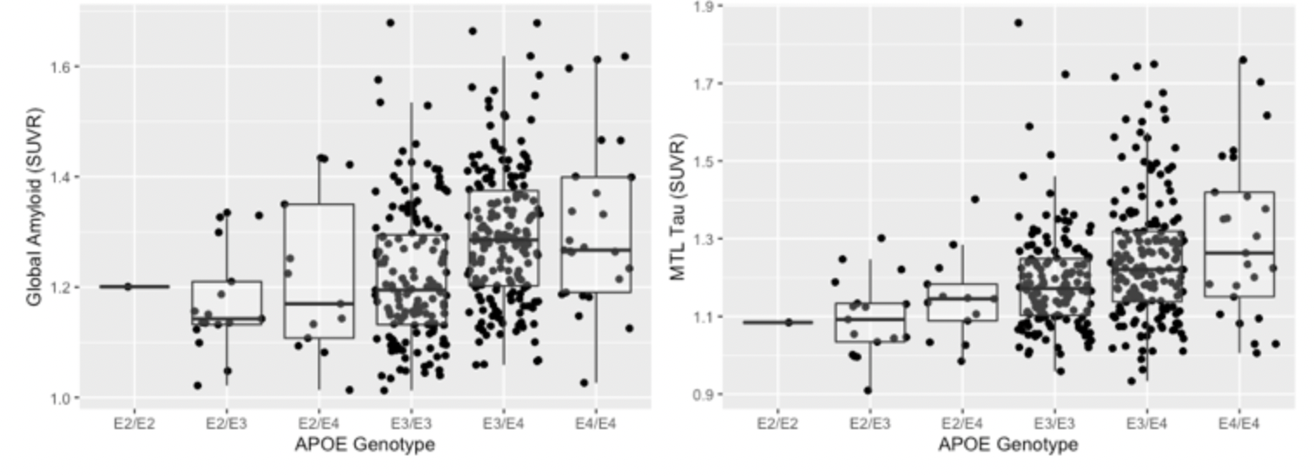
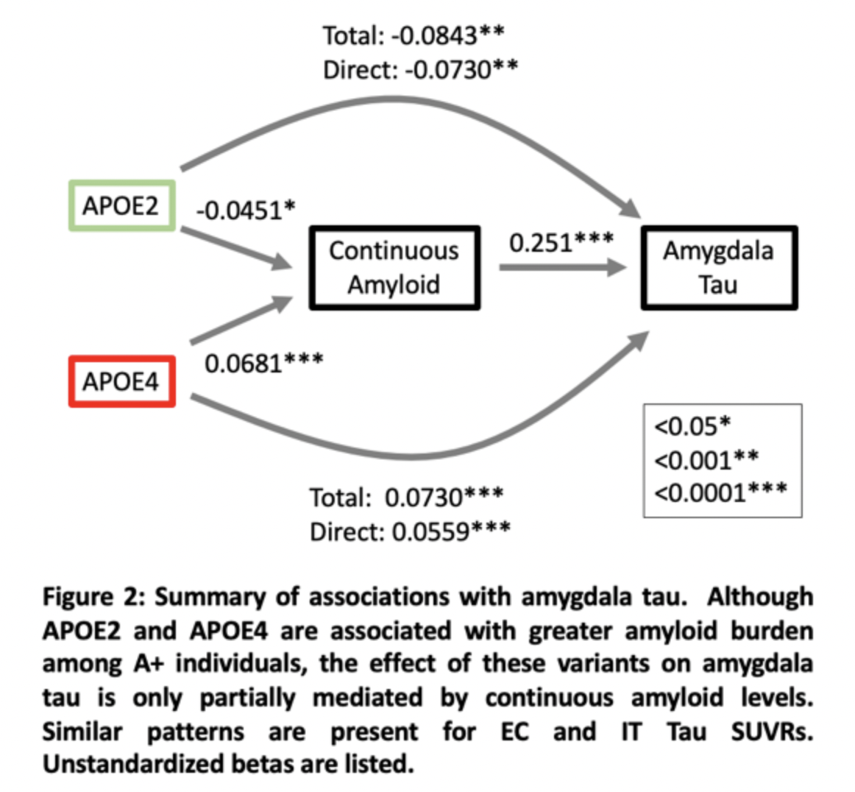
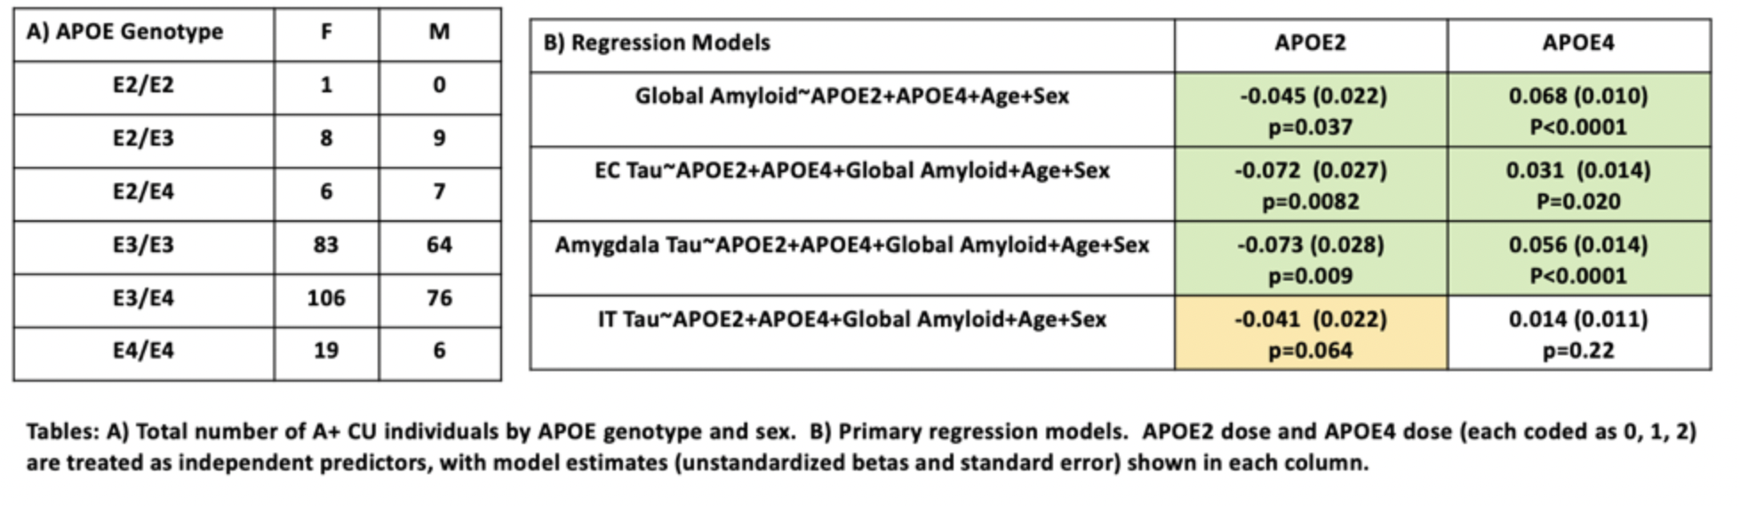
APOE2 is associated with amyloid independent effects on tau PET signal in preclinical AD
Notes:
Background: Although APOE is strongly associated with risk of amyloid-positivity during the preclinical stage of AD, less is known regarding independent effects on regional tau PET burden.
Method: We examined 385 Amyloid-positive (A+) clinically unimpaired (CU) individuals that had APOE genotype available and additionally underwent amyloid (florbetapir) and tau (flortaucipir) PET imaging as part of the A4-LEARN study (Table 1A, mean age=72.1±4.8). PET data were processed locally using FreeSurfer defined regions to quantify regional tau and combined to form a large cortical target composite for amyloid. Multiple regression was used to examine associations between APOE genotype (number of e2 and number of e4 modeled as two predictors) with global amyloid, regional tau (entorhinal, amygdala, and inferior temporal).
Result: Among the A+ group, each APOE2 allele was associated with a decrease of 0.045 SUVR while each APOE4 allele was associated with an increase of 0.068 SUVR units of global amyloid compared to the APOE3/3 group (Table 1B). APOE2 was significantly associated with reduced tau across medial temporal lobe ROIs whereas APOE4 was associated with elevated tau in the medial temporal lobe ROIs (Table 1B, Figure 1). Although continuous amyloid levels were associated both with APOE genotype, the total effect of both APOE2 and APOE4 dosage on tau PET was largely independent of continuous amyloid levels (Figure 2).
Conclusion: APOE genotype is related to early medial temporal lobe tau burden, independent of continuous amyloid burden within the A+ range. These findings highlight that APOE genotype influences heterogeneity in tau burden among individuals with preclinical AD.

Slide 7
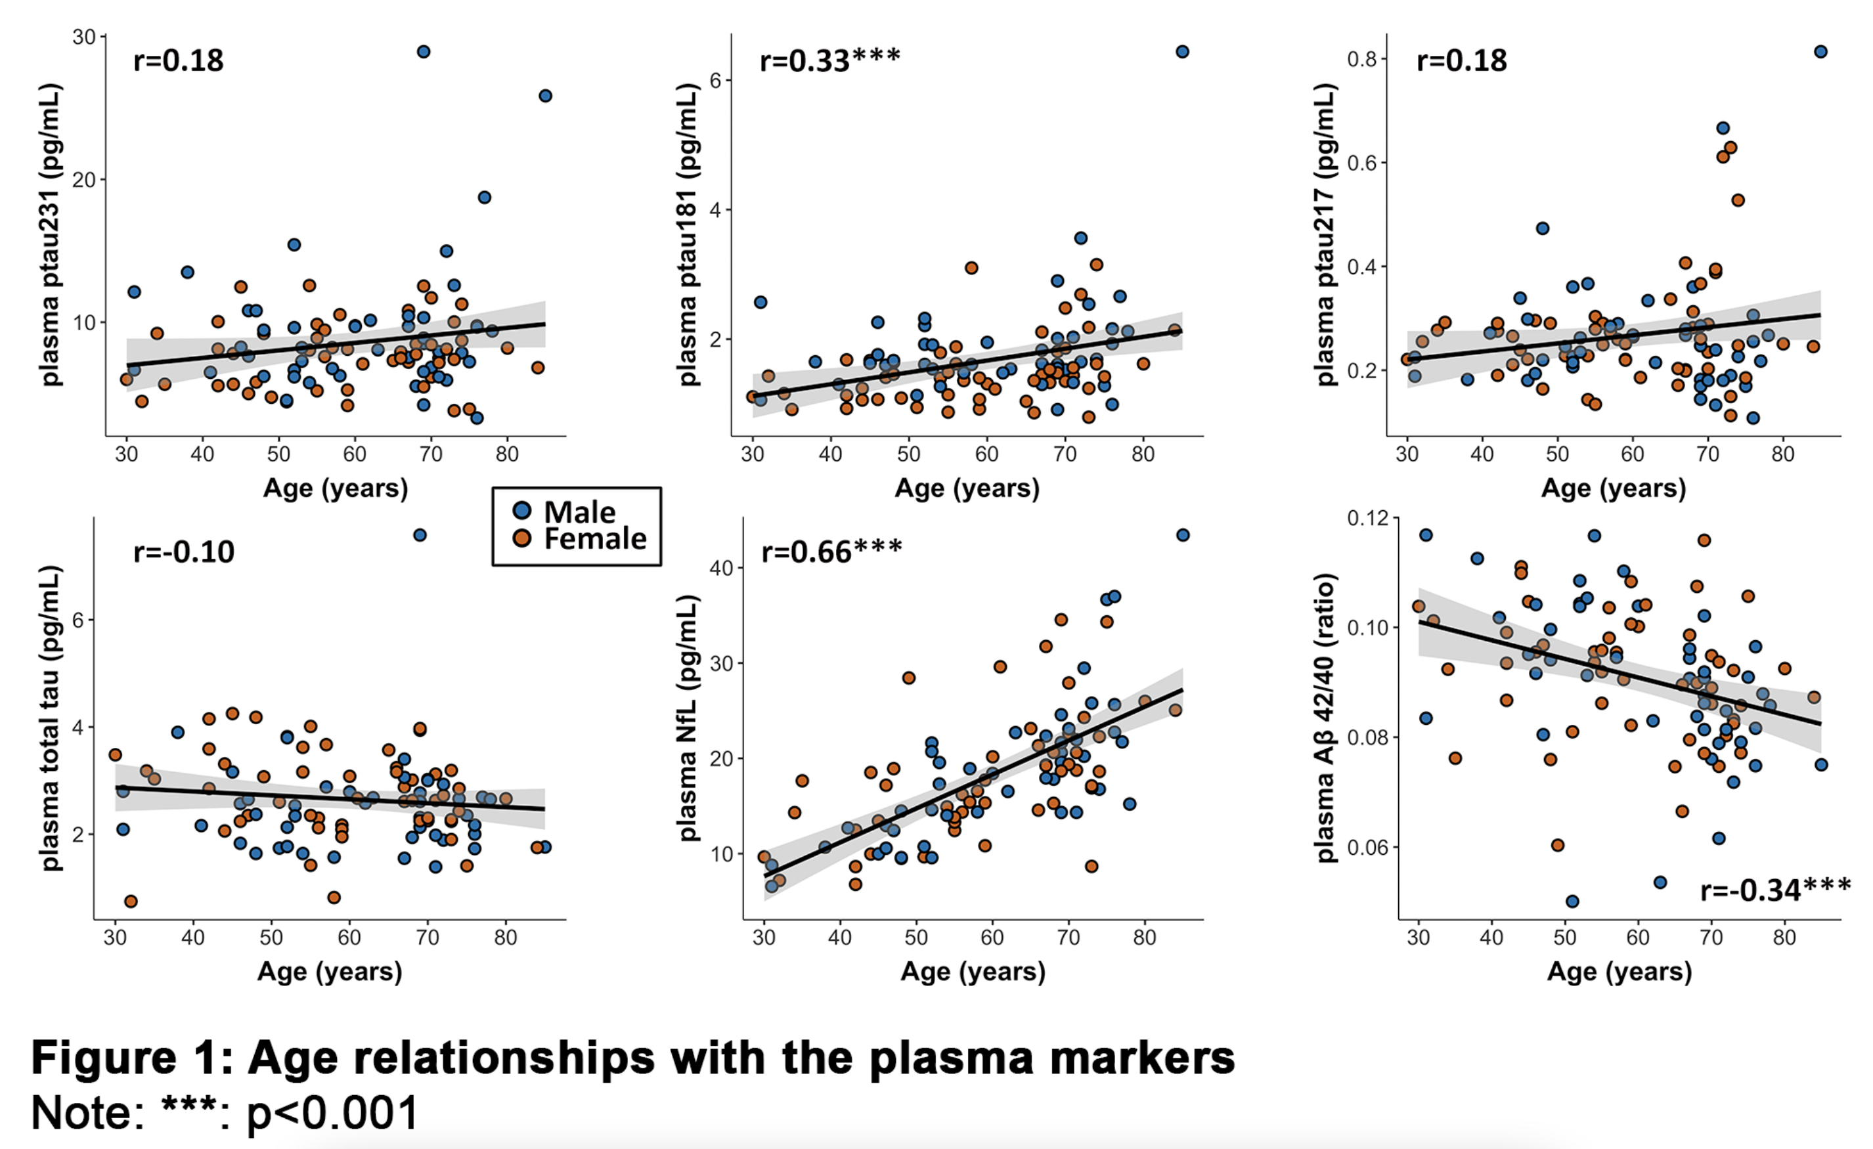
Plasma ptau231 predicts locus coeruleus integrity earlier in life than other Alzheimer’s disease plasma markers: a 7T MRI study across the adult lifespan
Notes:
Background:
Autopsy studies indicated that the locus coeruleus (LC) is one of the first regions to accumulate pretangle material, and imaging work demonstrated that the LC MRI-signal correlates with entorhinal tau in cognitively normal individuals. Recently developed phosphor-tau (ptau) blood-based biomarkers correlated well with cortical tau-PET and have been suggested as early markers of aberrant tau phosphorylation. Here we evaluated the relationship between LC-MRI signal intensity and plasma markers of tau (ptau₂₃₁, ptau₂₁₇, ptau₁₈₁), neurodegenerative processes (total tau (t-tau), neurofilament light (NfL)) and amyloidosis (Aβ_{42/40}).
Method:
99 cognitively normal individuals across the lifespan (30-85 years, n=52 female) underwent dedicated 7T LC-imaging and fasting blood draw. A sample-specific template for the LC was generated and transformed into a surface. All plasma markers were quantified in duplicate using Single molecule array methods (Simoa, Quanterix) or Meso-Scale Discovery. Voxel-wise robust regressions associated LC intensity values with plasma markers, adjusted for age and sex (or Aβ_{42/40}). Interactions between Aβ_{42/40} and ptau, t-tau or NfL were also tested. Multiple comparisons were corrected using Threshold-Free-Cluster-Enhancement (p<0.001). Bootstrapped sliding window analyses determined the age-window of significant plasma marker–LC intensity associations.
Result:
Older age was associated with higher ptau₁₈₁, NfL and lower Aβ_{42/40} (Figure 1). Higher ptau₂₃₁ was associated with lower LC intensity in bilateral dorso-rostral clusters. Ptau₁₈₁, ptau₂₁₇ and t-tau correlated negatively with LC intensity in right dorso-rostral clusters. Small clusters of negative associations between LC intensity and NfL were distributed across the length of the LC. LC intensity was not associated with Aβ_{42/40} (Figure 2). Adjusting for Aβ_{42/40} did not change these results. We did not find interactions between Aβ_{42/40} and ptau, t-tau or NfL. The association between LC intensity and ptau231 became significant from age 55.5 years, and for ptau₁₈₁ and ptau₂₁₇ from age 60 years (Figure 3).
Conclusion:
Plasma ptau₂₃₁ showed robust and earlier relationships with LC intensity compared to ptau₂₁₇ or ptau₁₈₁ in asymptomatic individuals across the lifespan. Given that tau phosphorylation at threonine 231 is one of the earliest events in the phosphorylation cascade hindering tubulin assembly, these findings suggest that LC intensity may reflect processes related to early tau aggregation.

Slide 8
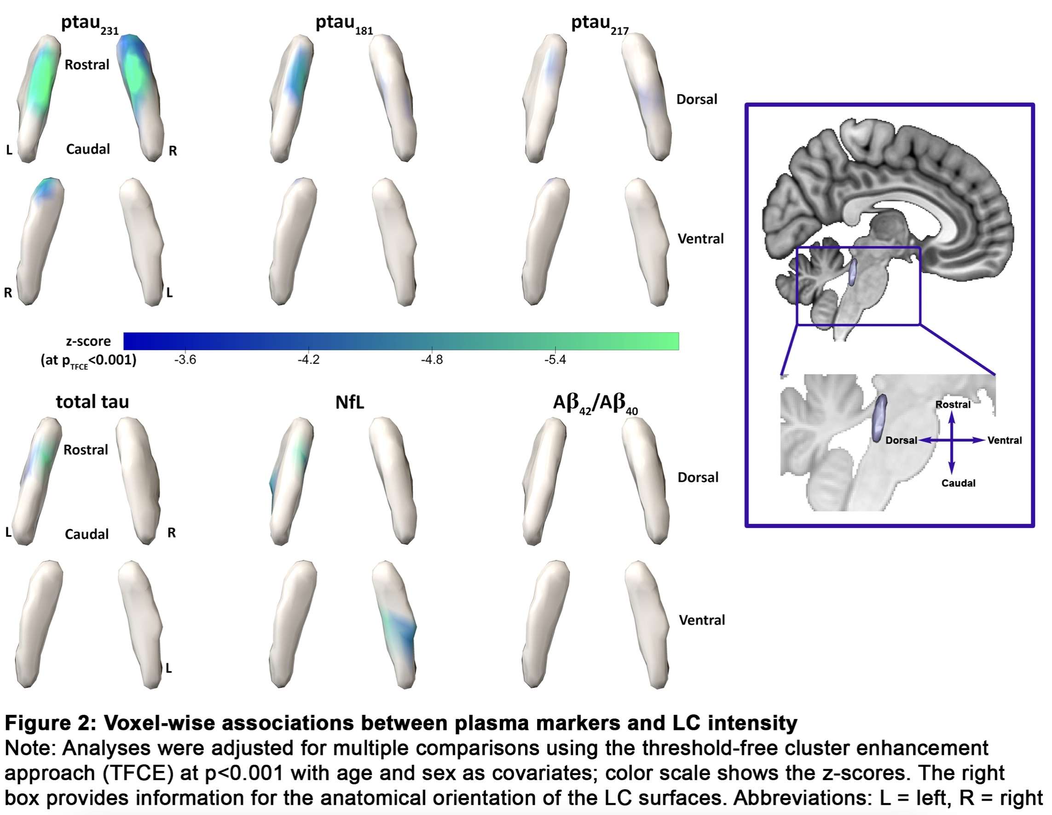
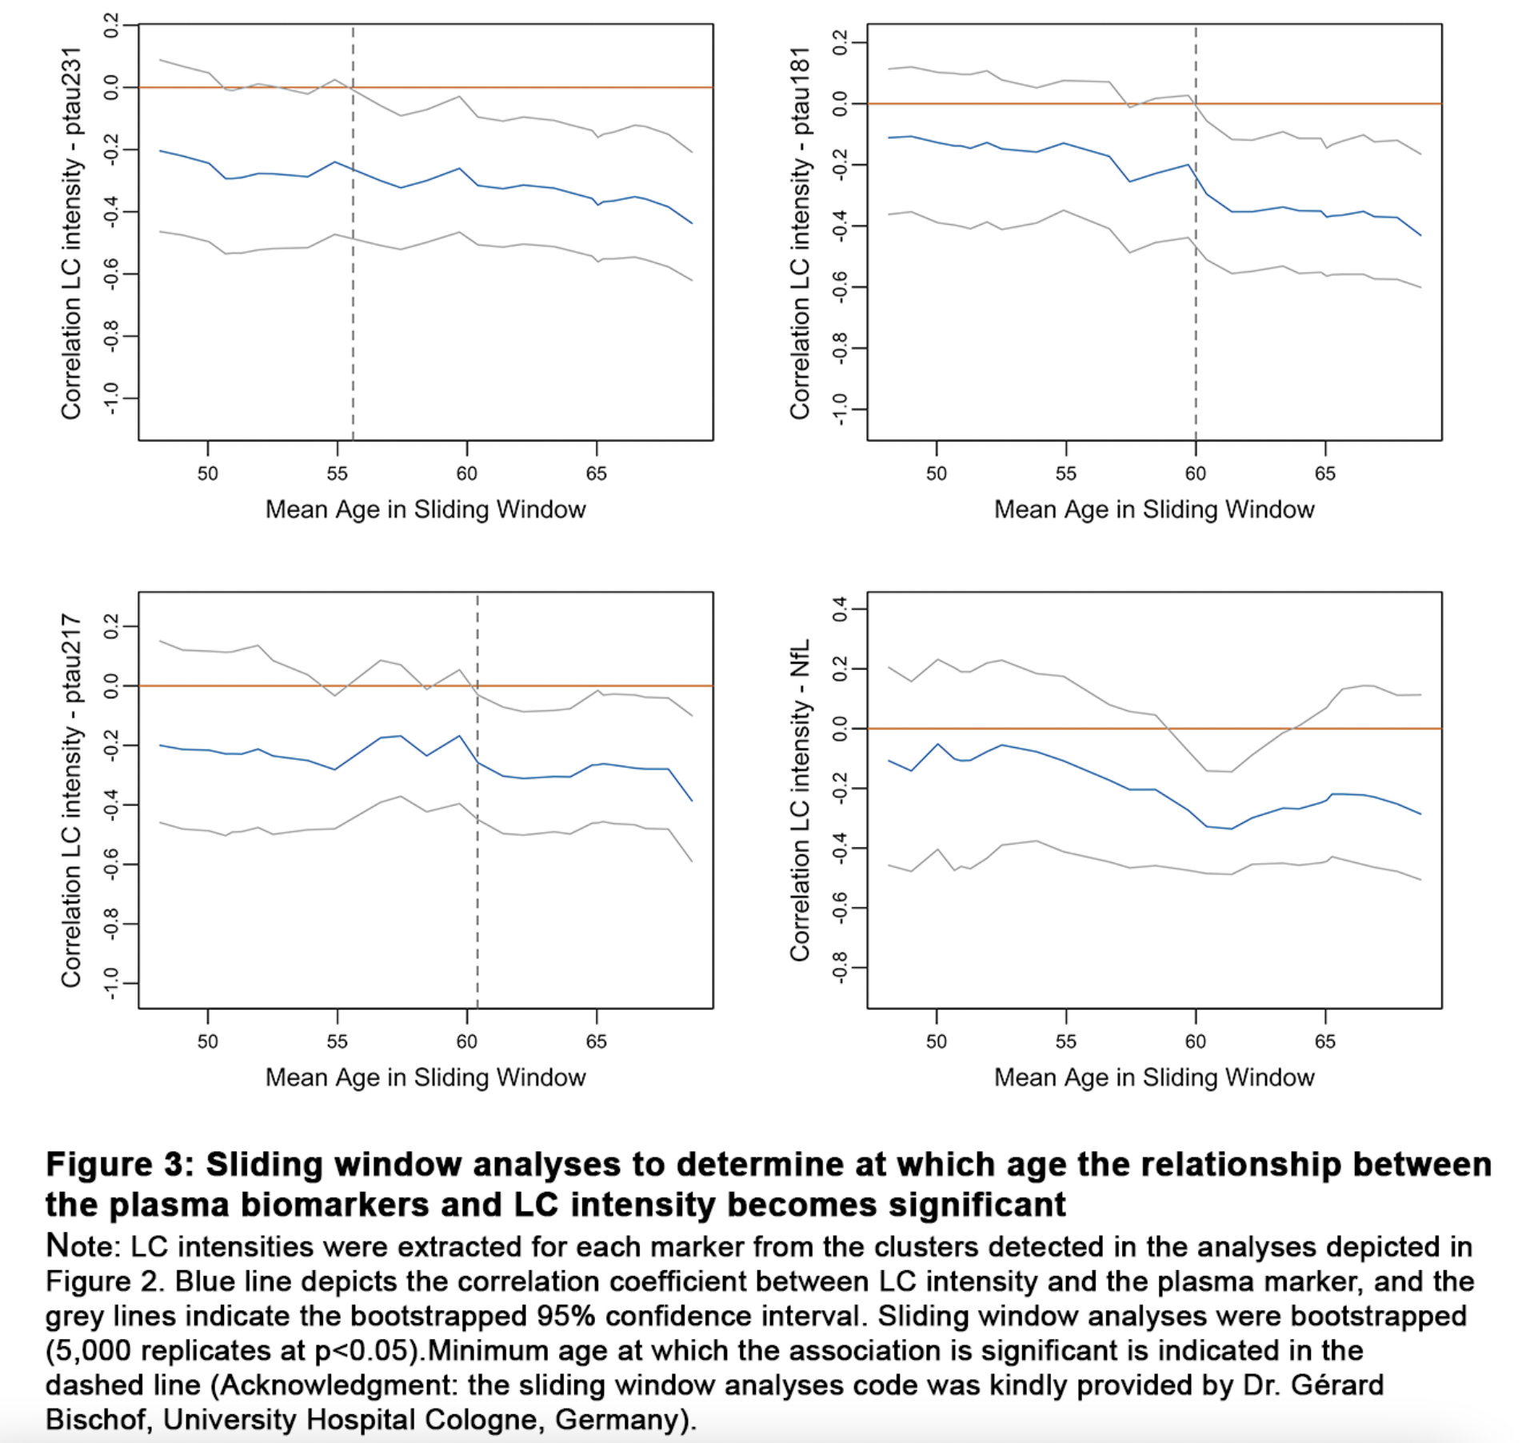
Plasma ptau231 predicts locus coeruleus integrity earlier in life than other Alzheimer’s disease plasma markers: a 7T MRI study across the adult lifespan
Notes:
ackground:
Autopsy studies indicated that the locus coeruleus (LC) is one of the first regions to accumulate pretangle material, and imaging work demonstrated that the LC MRI-signal correlates with entorhinal tau in cognitively normal individuals. Recently developed phosphor-tau (ptau) blood-based biomarkers correlated well with cortical tau-PET and have been suggested as early markers of aberrant tau phosphorylation. Here we evaluated the relationship between LC-MRI signal intensity and plasma markers of tau (ptau₂₃₁, ptau₂₁₇, ptau₁₈₁), neurodegenerative processes (total tau (t-tau), neurofilament light (NfL)) and amyloidosis (Aβ_{42/40}).
Method:
99 cognitively normal individuals across the lifespan (30-85 years, n=52 female) underwent dedicated 7T LC-imaging and fasting blood draw. A sample-specific template for the LC was generated and transformed into a surface. All plasma markers were quantified in duplicate using Single molecule array methods (Simoa, Quanterix) or Meso-Scale Discovery. Voxel-wise robust regressions associated LC intensity values with plasma markers, adjusted for age and sex (or Aβ_{42/40}). Interactions between Aβ_{42/40} and ptau, t-tau or NfL were also tested. Multiple comparisons were corrected using Threshold-Free-Cluster-Enhancement (p<0.001). Bootstrapped sliding window analyses determined the age-window of significant plasma marker–LC intensity associations.
Result:
Older age was associated with higher ptau₁₈₁, NfL and lower Aβ_{42/40} (Figure 1). Higher ptau₂₃₁ was associated with lower LC intensity in bilateral dorso-rostral clusters. Ptau₁₈₁, ptau₂₁₇ and t-tau correlated negatively with LC intensity in right dorso-rostral clusters. Small clusters of negative associations between LC intensity and NfL were distributed across the length of the LC. LC intensity was not associated with Aβ_{42/40} (Figure 2). Adjusting for Aβ_{42/40} did not change these results. We did not find interactions between Aβ_{42/40} and ptau, t-tau or NfL. The association between LC intensity and ptau231 became significant from age 55.5 years, and for ptau₁₈₁ and ptau₂₁₇ from age 60 years (Figure 3).
Conclusion:
Plasma ptau₂₃₁ showed robust and earlier relationships with LC intensity compared to ptau₂₁₇ or ptau₁₈₁ in asymptomatic individuals across the lifespan. Given that tau phosphorylation at threonine 231 is one of the earliest events in the phosphorylation cascade hindering tubulin assembly, these findings suggest that LC intensity may reflect processes related to early tau aggregation.

Slide 9
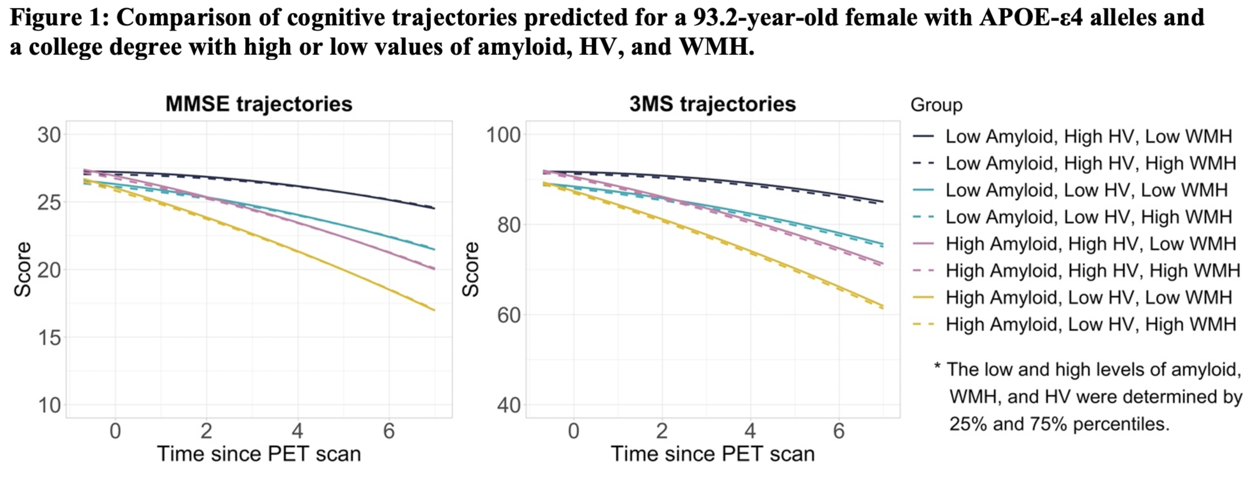
Associations of Amyloid, White Matter Hyperintensities, and Hippocampal Volume with Cognitive Trajectories in the Oldest-Old: The 90+ Study
Notes:
Background: Amyloid pathology, vascular disease pathology, and hippocampal atrophy are associated with cognitive trajectories in older adults. However, there is almost no prior evidence on how these pathologies influence cognition in the oldest-old.
Method: We included 216 individuals from The 90+ Study, a longitudinal study of aging and dementia in people aged 90 years and older, who had ¹⁸F-florbetapir PET and MRI imaging. We examined the association of amyloid, white matter hyperintensities (WMH) volume, and hippocampal volume (HV) with baseline cognition and longitudinal cognitive decline. Amyloid burden was measured using the standardized uptake value ratio (SUVR) in the precuneus/posterior cingulate with white matter mask as reference. WMH volume and HV were normalized by intracranial volume (IV) and normalized WMH were log-transformed. SUVR and HV for each individual were Z-scored using the sample mean and standard deviation. Global cognitive performance was measured by Mental State Examination (MMSE) and modified MMSE (3MS) tests, repeated every six months. We defined baseline (time=0) as the visit closest to the PET imaging and included all visits starting from one year before baseline (time=-1). We used linear mixed-effects models with a random intercept to estimate the effect of pathologies on cognitive trajectories. All models included baseline age, sex, education, APOE-ε4, time, time squared, amyloid, WMH, HV, and interactions between linear time and pathology variables.
Result: At baseline, participants were 93.2 years old on average, 65.3% were females, 10.6% were APOE-ε4 carriers, and 66.2% had normal cognition (Table 1). Higher HV was associated with higher MMSE and 3MS scores at baseline. Both lower amyloid burden and higher HV were associated with slower rate of cognitive decline longitudinally. WMH was not associated with baseline cognition or cognitive trajectory. Parameter estimates are shown in Table 2 and illustrative cognitive trajectories predicted for a 93.2-year-old female with APOE-ε4 alleles and a college degree predicted at varying degrees of amyloid, HV, and WMH are shown in Figure 1.
Conclusion: Amyloid burden and HV are associated with longitudinal cognitive trajectories, highlighting the utility of amyloid and HV in predicting future cognitive decline for the oldest-old.

Slide 10
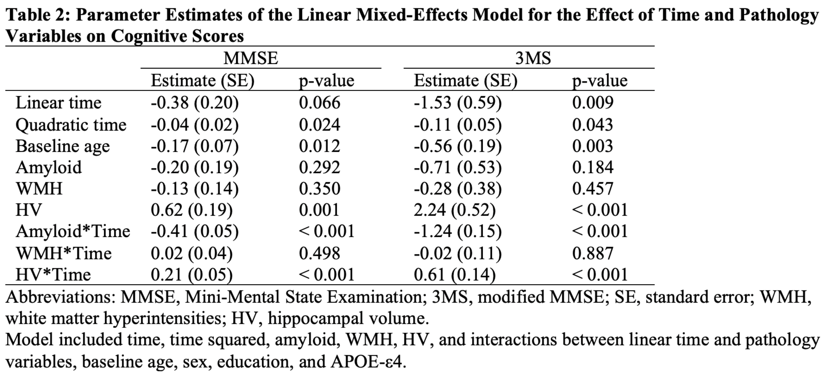
Associations of Amyloid, White Matter Hyperintensities, and Hippocampal Volume with Cognitive Trajectories in the Oldest-Old: The 90+ Study
Notes:
Background: Amyloid pathology, vascular disease pathology, and hippocampal atrophy are associated with cognitive trajectories in older adults. However, there is almost no prior evidence on how these pathologies influence cognition in the oldest-old.
Method: We included 216 individuals from The 90+ Study, a longitudinal study of aging and dementia in people aged 90 years and older, who had ¹⁸F-florbetapir PET and MRI imaging. We examined the association of amyloid, white matter hyperintensities (WMH) volume, and hippocampal volume (HV) with baseline cognition and longitudinal cognitive decline. Amyloid burden was measured using the standardized uptake value ratio (SUVR) in the precuneus/posterior cingulate with white matter mask as reference. WMH volume and HV were normalized by intracranial volume (IV) and normalized WMH were log-transformed. SUVR and HV for each individual were Z-scored using the sample mean and standard deviation. Global cognitive performance was measured by Mental State Examination (MMSE) and modified MMSE (3MS) tests, repeated every six months. We defined baseline (time=0) as the visit closest to the PET imaging and included all visits starting from one year before baseline (time=-1). We used linear mixed-effects models with a random intercept to estimate the effect of pathologies on cognitive trajectories. All models included baseline age, sex, education, APOE-ε4, time, time squared, amyloid, WMH, HV, and interactions between linear time and pathology variables.
Result: At baseline, participants were 93.2 years old on average, 65.3% were females, 10.6% were APOE-ε4 carriers, and 66.2% had normal cognition (Table 1). Higher HV was associated with higher MMSE and 3MS scores at baseline. Both lower amyloid burden and higher HV were associated with slower rate of cognitive decline longitudinally. WMH was not associated with baseline cognition or cognitive trajectory. Parameter estimates are shown in Table 2 and illustrative cognitive trajectories predicted for a 93.2-year-old female with APOE-ε4 alleles and a college degree predicted at varying degrees of amyloid, HV, and WMH are shown in Figure 1.
Conclusion: Amyloid burden and HV are associated with longitudinal cognitive trajectories, highlighting the utility of amyloid and HV in predicting future cognitive decline for the oldest-old.

Slide 11
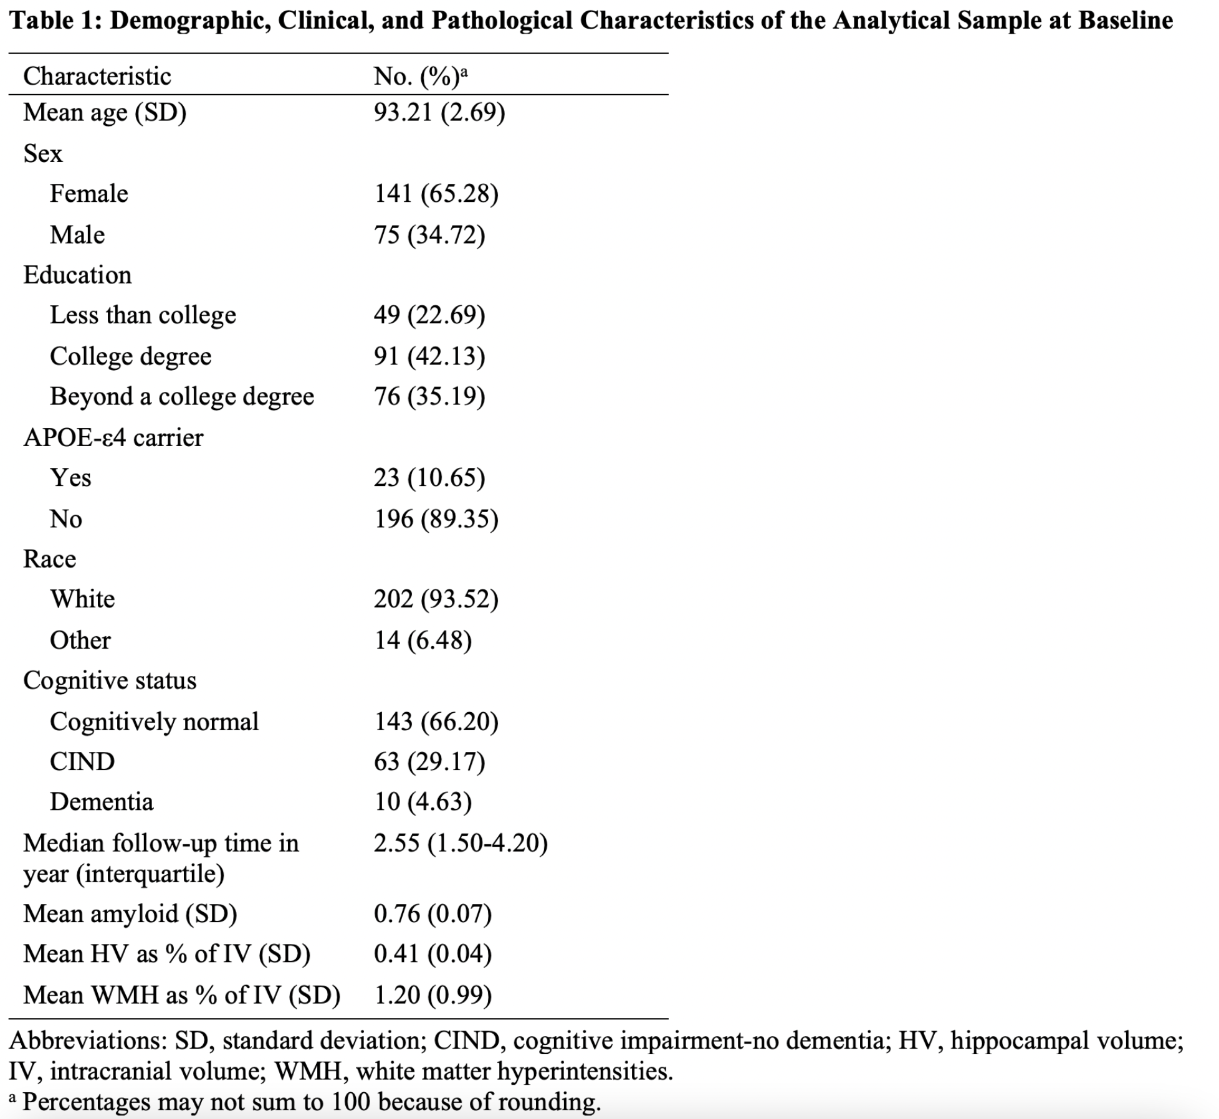
Associations of Amyloid, White Matter Hyperintensities, and Hippocampal Volume with Cognitive Trajectories in the Oldest-Old: The 90+ Study
Notes:
Background: Amyloid pathology, vascular disease pathology, and hippocampal atrophy are associated with cognitive trajectories in older adults. However, there is almost no prior evidence on how these pathologies influence cognition in the oldest-old.
Method: We included 216 individuals from The 90+ Study, a longitudinal study of aging and dementia in people aged 90 years and older, who had ¹⁸F-florbetapir PET and MRI imaging. We examined the association of amyloid, white matter hyperintensities (WMH) volume, and hippocampal volume (HV) with baseline cognition and longitudinal cognitive decline. Amyloid burden was measured using the standardized uptake value ratio (SUVR) in the precuneus/posterior cingulate with white matter mask as reference. WMH volume and HV were normalized by intracranial volume (IV) and normalized WMH were log-transformed. SUVR and HV for each individual were Z-scored using the sample mean and standard deviation. Global cognitive performance was measured by Mental State Examination (MMSE) and modified MMSE (3MS) tests, repeated every six months. We defined baseline (time=0) as the visit closest to the PET imaging and included all visits starting from one year before baseline (time=-1). We used linear mixed-effects models with a random intercept to estimate the effect of pathologies on cognitive trajectories. All models included baseline age, sex, education, APOE-ε4, time, time squared, amyloid, WMH, HV, and interactions between linear time and pathology variables.
Result: At baseline, participants were 93.2 years old on average, 65.3% were females, 10.6% were APOE-ε4 carriers, and 66.2% had normal cognition (Table 1). Higher HV was associated with higher MMSE and 3MS scores at baseline. Both lower amyloid burden and higher HV were associated with slower rate of cognitive decline longitudinally. WMH was not associated with baseline cognition or cognitive trajectory. Parameter estimates are shown in Table 2 and illustrative cognitive trajectories predicted for a 93.2-year-old female with APOE-ε4 alleles and a college degree predicted at varying degrees of amyloid, HV, and WMH are shown in Figure 1.
Conclusion: Amyloid burden and HV are associated with longitudinal cognitive trajectories, highlighting the utility of amyloid and HV in predicting future cognitive decline for the oldest-old.

Slide 12
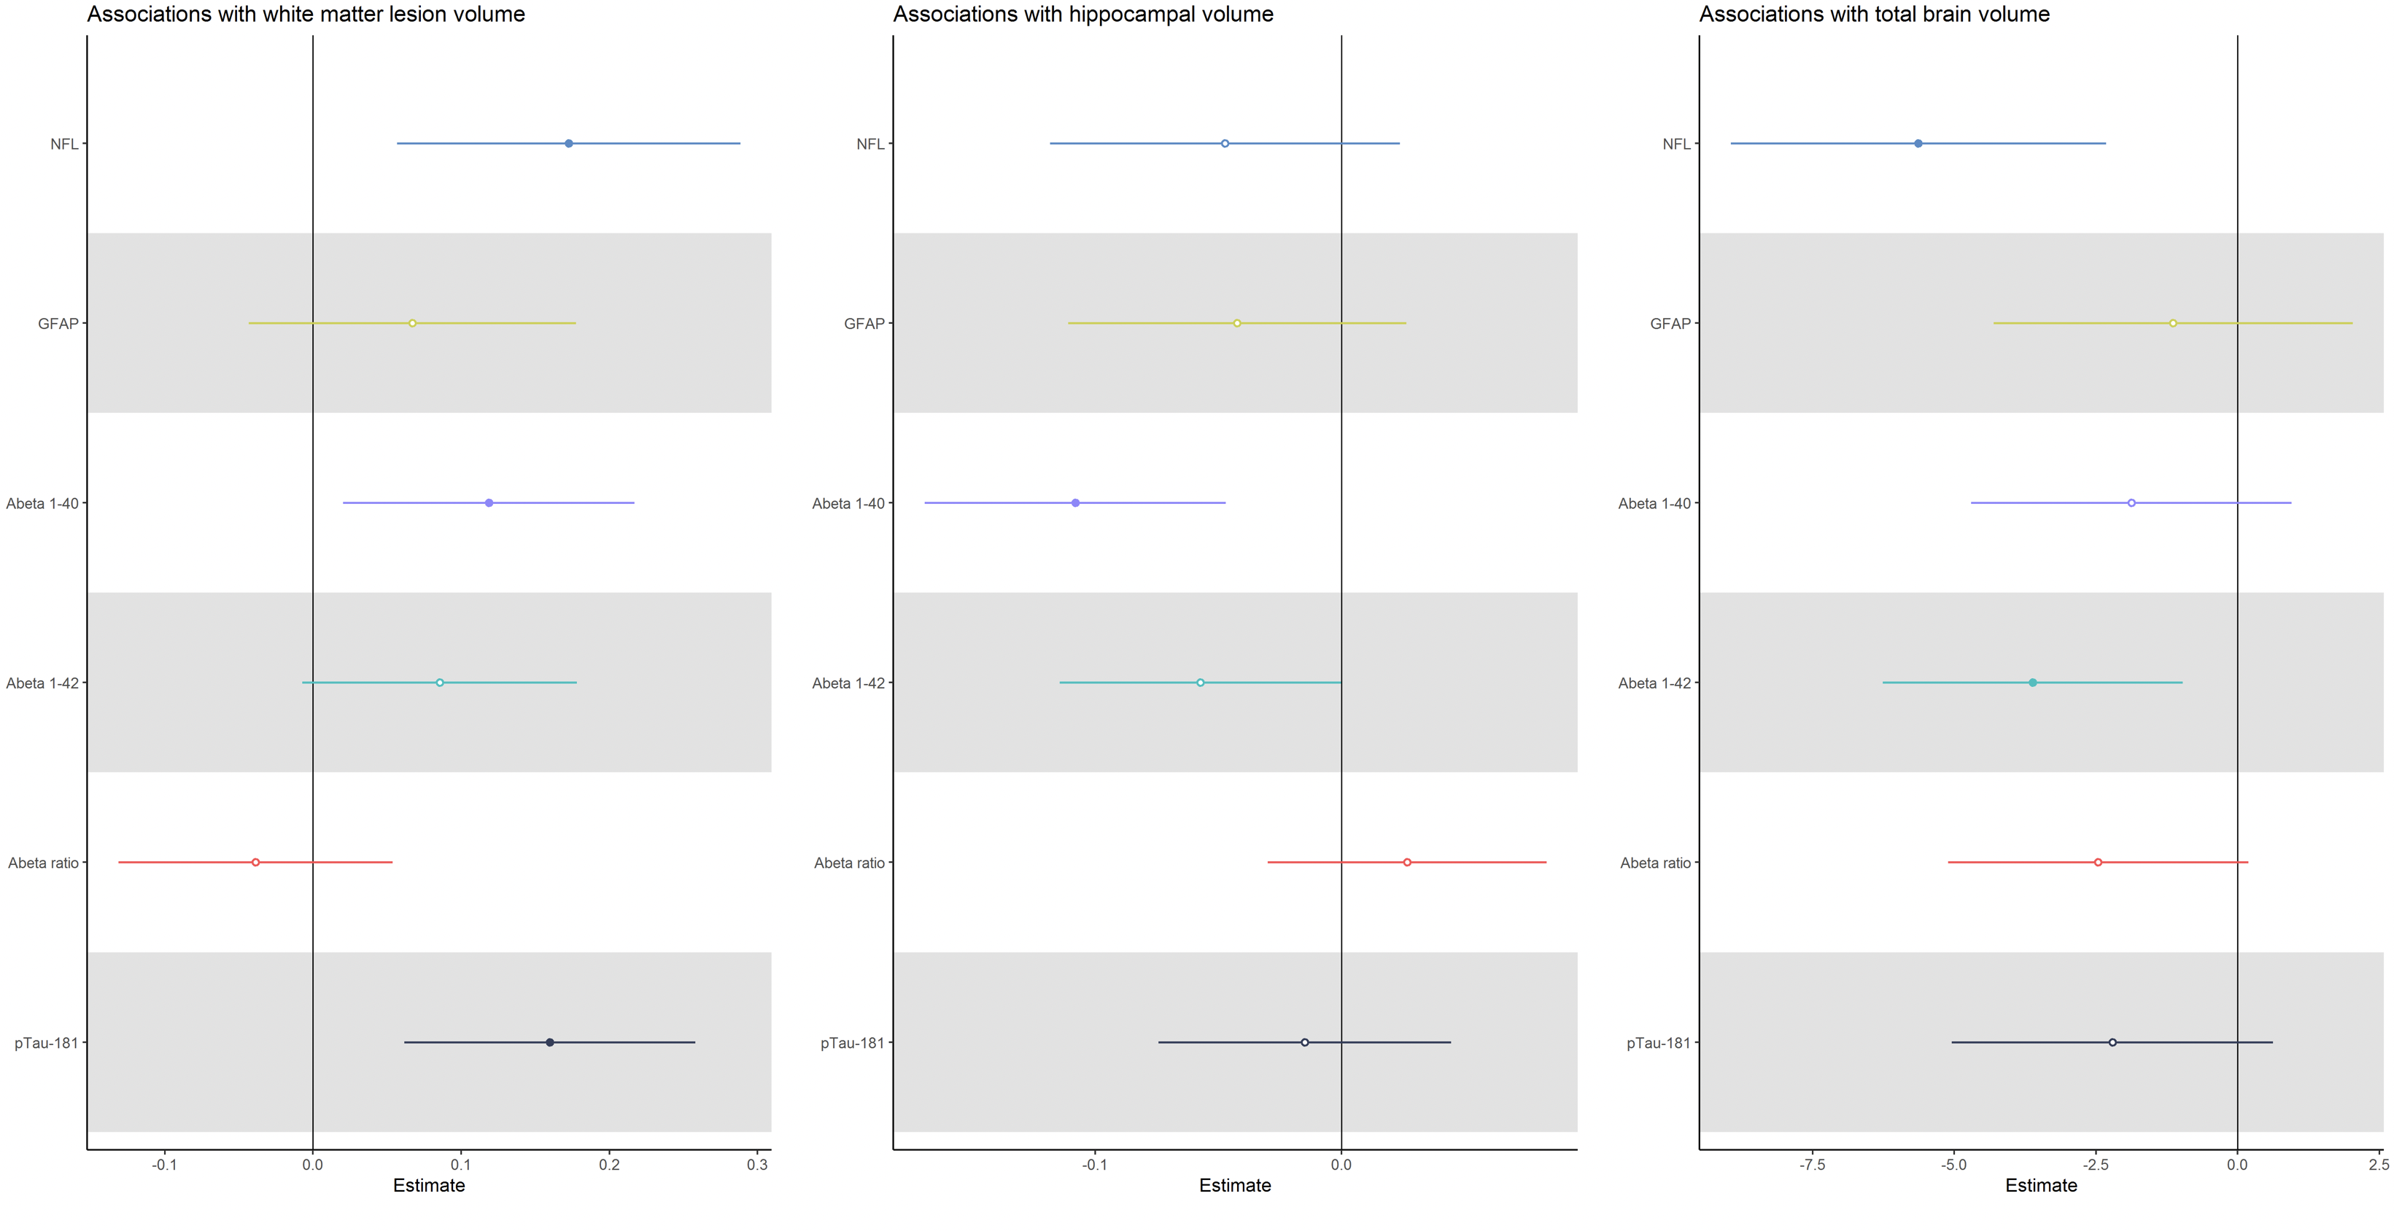
Association between plasma Alzheimer’s disease markers and MRI markers of cerebral small vessel disease and neurodegeneration: the SMART-MR Study
Notes:
Background: Biomarkers for Alzheimer’s disease (AD), including amyloid-beta (Abeta) and phosphorylated-tau have recently been accurately detected in blood. Non-specific biomarkers such as neurofilament light (NFL) and glial fibrillary acidic protein (GFAP) have been added as complementary biomarkers to fully investigate AD etiology in vivo. This has increased the possibility to examine relationships with other pathways to AD, such as white matter hyperintensities (WMH) and brain atrophy on MRI. Our aim was to explore the relationship between plasma AD biomarkers and MRI markers of cerebral small vessel disease and neurodegeneration in mid- and late life.
Method: Data from 594 individuals (mean (SD) age: 64 (8) years; 17% female) were included from the SMART-MR Study, a prospective cohort study of non-demented individuals with a history of vascular disease from the UMC Utrecht in the Netherlands. MRI markers of CSVD included WMH, presence of infarcts, total brain volume (TBV), and hippocampal volume (HV) assessed on 1.5T MRI. AD plasma markers (Abeta1-40, Abeta1-42, pTau-181, NFL, and GFAP) were assessed using Single Molecular Array (Simoa; Quanterix) assays. Linear regressions were performed for each plasma marker, as well as Abeta1-42/Abeta1-40 ratio, with age, sex, education, and intracranial volume, with WMH volume, TBV, and HV. Additionally, logistic regressions were performed for the presence of infarcts, including lacunar infarcts and cortical infarcts, corrected for age, sex, and education. Plasma AD levels were converted to z-scores. P < 0.01 was considered statistically significant.
Result: Higher NFL and pTau-181 were associated with larger WMH volume (B NFL=0.17, 95% CI=0.06;0.29, p=0.003; B pTau-181=0.16, 95% CI=0.06;0.26, p=0.001). Higher Abeta1-40 (B=-0.11, 95% CI=-0.17;-0.05, p<0.001) levels were associated with lower HV. Higher NFL (B=-5.63, 95% CI=-8.95;-2.31, p<0.001) and Abeta1-42 (B=-3.61, 95% CI=-6.26;-0.96, p=0.008) were associated with lower TBV. Regarding infarcts, higher NFL was associated with any infarct (OR=1.42, 95% CI=1.13;1.78, p=0.003). Higher GFAP was marginally associated only with cortical infarcts (OR=1.45, 95% CI=1.09;1.92, p=0.01).
Conclusion: Within non-demented adults with a history vascular disease, plasma AD markers differentially mapped to MRI markers. NFL and pTau-181 were associated with markers reflecting vascular damage, whereas amyloid markers were associated with atrophy in the TBV and HV.

Slide 13
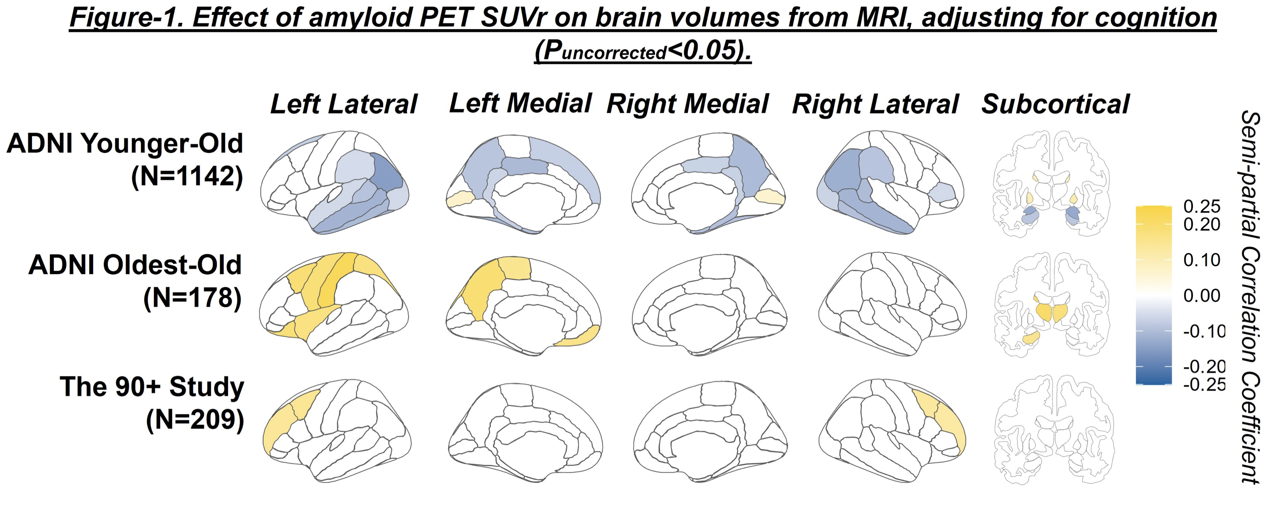
Amyloid burden is not associated with brain atrophy in the oldest-old
Notes:
Background:
Alzheimer’s disease (AD) is an important contributor to brain atrophy in older individuals. However, in the oldest-old (≥85 years), where multiple pathologies are common and contribute to brain atrophy, the relationship between AD and brain atrophy may be attenuated. Here we examined associations between amyloid burden and brain volumes in oldest-old participants and compared this to younger-old.
Method:
We used data from participants in the Alzheimer’s Disease Neuroimaging Initiative (ADNI) and The 90+ Study who had both MRI and florbetapir amyloid PET scans. We examined the association between volumes of brain structures (from FreeSurfer-v7) and amyloid standardized uptake value ratios (SUVr) using multiple linear regressions adjusted for age, sex, and education. We performed two different analyses, with and without adjusting for cognitive status. For ADNI we used the summary cortical region SUVr normalized to composite white-matter/brainstem/cerebellum reference, and for The 90+ Studywe used a precuneus/posterior-cingulate SUVr normalized to eroded white matter. Oldest-old (≥85 years) data were obtained from The 90+ Study (N=206) and ADNI (N=178) whereas younger-old (55 to 85 years) data (N=1134) came exclusively from the ADNI cohort. We display semi-partial correlations (sr) as measures of effect size, thresholded at P_{uncorrected}<0.05.
Result:
Table-1 summarizes participant characteristics for ADNI and The 90+ Study. In younger-old participants amyloid was related to atrophy of multiple regions (sr~-0.1), but in the oldest-old the opposite was true, where amyloid was weakly associated with increased volume in some regions for both ADNI and The 90+ Study (Figure-1). In the model without adjusting for cognitive status, the atrophic effect of amyloid on brain volumes was more pronounced in the younger-old (sr~-0.3), while amyloid remained unrelated to brain atrophy in the oldest-old (Figure-2). Lastly, we further illustrate this effect by plotting volumes for two regions, the hippocampus and inferior temporal, against SUVrs for the different groups (Figure-3).
Conclusion:
We found that in the oldest-old amyloid burden was not related to brain atrophy. This finding underscores the importance of non-AD pathologies and/or general aging processes compared with AD pathology in the oldest-old.

Slide 14
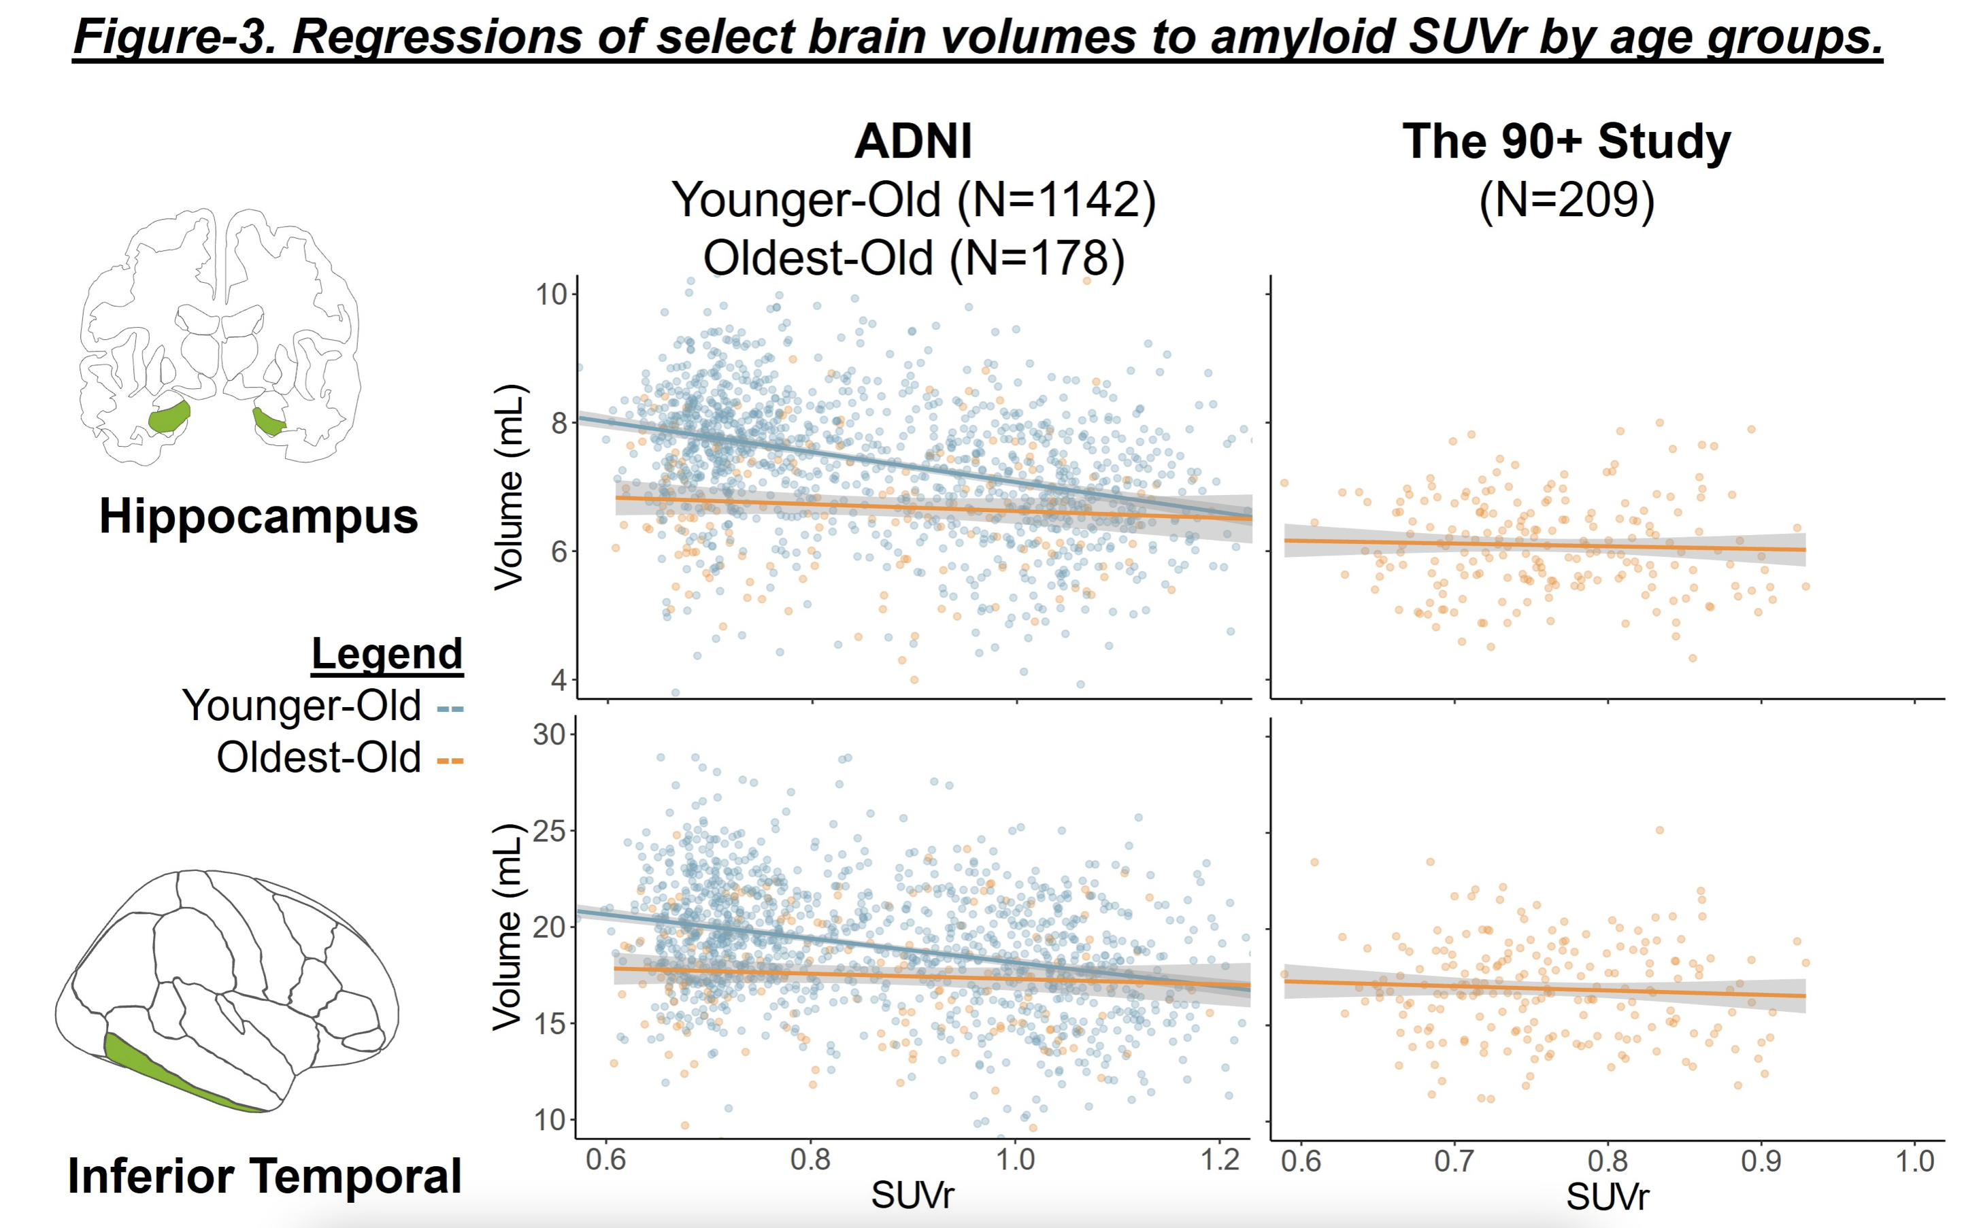
Amyloid burden is not associated with brain atrophy in the oldest-old

Slide 15
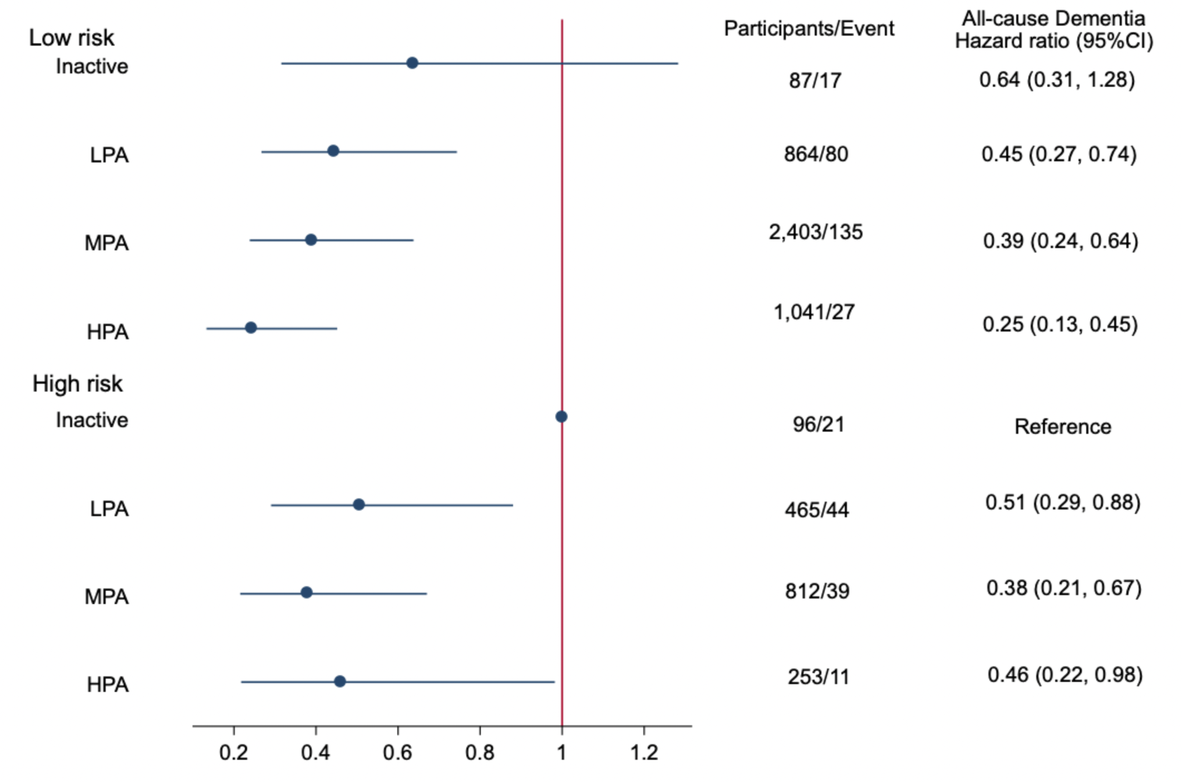
Prevention (non-pharmacological): Exercise and Cognition: More evidence from across the lifespan
Alzheimer’s Disease Proteinopathy and Synaptic Integrity: The Protective Role of Physical Activity (Shannon Y. Lee, UCSF)
Becoming physically active or maintaining physical activity during midlife is associated with biomarkers of amyloid-beta, microglia, and temporal lobe integrity (Muge Akinci, Universitat Pompeu Fabra)
Physical activity reverted the increased risk of dementia associated with cardiovascular risk factors: findings a population-based cohort study (Natan Feter, Universidade Federal de Pelotas)
Notes:
Background: Cardiovascular risk factors are associated with a higher risk of dementia. However, whether physical activity could revert this increased risk remains uncertain. We analyzed the effect of physical activity on the risk of dementia stratified by cardiovascular risk factors.
Methods: Data from baseline (2002-2003) to wave 9 (2018-2019) of the English Longitudinal Study of Ageing (ELSA) were analyzed (n=6,021). The wave that dementia was first detected after baseline was defined as the event time. Self-reported physical activity (inactive, low, moderate, high) at baseline was measured using a validated questionnaire. Smoking, excessive alcohol consumption, hypertension, diabetes, and obesity were analyzed as cardiovascular risk factors. Participants with simultaneous presence of 2+ risk factors were classified with a high cardiovascular risk for dementia. Socioeconomic, behavioral, and health variables were added in the Cox proportional hazard regression model as possible confounders. The incidence and the risk of dementia for physical activity, cardiovascular risk factors, and their interaction were calculated.
Result: Between baseline and wave 9, 6.21% (95% confidence interval [CI]: 5.63 to 6.85) of the participants were diagnosed with dementia. Participants with 2+ cardiovascular risk factors had a higher risk of dementia (hazard ratio [HR]: 1.31; 95%CI: 1.04, 1.63) than low-risk adults. Physical activity level was inversely associated with the risk of incident dementia in participants who were smokers (p for linear trend=0.027), had hypertension (p for linear trend=0.015), and obesity (p for linear trend=0.014). Low physical activity level (e.g., engaging in moderate-intensity physical activity once per week) reduced the risk of dementia in participants with hypertension (HR: 0.41; 95%CI: 0.24, 0.70), and obesity (HR: 0.37; 95%CI: 0.21, 0.67). Physical activity attenuated the increased risk of incident dementia provoked by accumulated cardiovascular risk factors. High risk participants with low (HR: 0.51; 95%CI: 0.29, 0.88), moderate (HR: 0.38; 95%CI: 0.21, 0.67) and high (HR: 0.46; 95%CI: 0.22, 0.98) physical activity level had lower risk of dementia than the high risk, inactive group. Sensitivity analyses confirmed the above-mentioned findings.
Conclusion: Physical activity starting at moderate-intensity activities once per week attenuated the increased risk of dementia associated with cardiovascular risk factors in older adults.

Slide 16
